Slide 1
Dynamic programming: Longest common subsequences
Session 17
Henry Lucky, S.Kom. M.Kom.

Slide 2
Outline Materials
Session 04
Longest common subsequences problem
Solving longest common subsequences problem

Slide 3
Learning outcomes
LO 1: Explain fundamental concept of analysis algorithms
LO 2: Apply algorithm techniques and methods
LO 3: Solve a problem using specific algorithm.
LO 4: Compare several algorithm design methods

Slide 4
Longest common subsequences problem
Formally, given a sequence X = (x1, x2, …, xm), another sequence Z = (z1, z1, …, zk) is a subsequence of X if there exist a strictly increasing sequence (i1, i2, …, ik) of indices of X such that for all j = 1, 2, …, k, we have xij = zj.
For example, Z = (B, C, D, B) is a subsequence of X = (A, B, C, B, D, A, B) with corresponding index sequence (2, 3, 5, 7)

Slide 5
Longest common subsequences problem
For a common subsequence of X and Y, consider this example:
X = (A, B, C, B, D, A, B)
Y = (B, D, C, A, B, A)
(B, C, A) is a common subsequence of both X and Y.
(B, C, B, A) or (B, C, A, B) is the longest common subsequence of X and Y.
In the longest-common-subsequence problem, the input is two sequences X = (x1, x2, …, xm) and Y = (y1, y2, …, yn), and the goal is to find a maximum-length common subsequence of X and Y.

Slide 6

Solving longest common subsequences problem
Step 1: Characterizing a longest common subsequence
You can solve the LCS problem with a brute-force approach: enumerate all subsequences of X and check each subsequence to see whether it is also a subsequence of Y, keeping track of the longest subsequence you find.
Each subsequence of corresponds to a subset of the indices (1, 2, …, m) of X.
Because X has $2^{m}$ subsequences, this approach is impractical for long sequences.

Slide 7

Solving longest common subsequences problem
Step 1: Characterizing a longest common subsequence
Optimal substructure of LCS:
Let X = (x1, x2, …, xm) and Y = (y1, y2, …, yn) be sequences and let Z = z1, z2, …, zk) be any LCS of X and Y.
If xm = yn, then zk = xm = yn and Zk-1 is an LCS of Xm-1 and Yn-1.
If xm $≠$ yn and zk $≠$ xm, then Z is an LCS of Xm-1 and Y.
If xm $≠$ yn and zk $≠$ yn, then Z is an LCS of X and Yn-1.
The theorem above says that an LCS of two sequences contains within it an LCS of prefixes of the two sequences.
Thus, the LCS problem has an optimal-substructure property.

Slide 8
Solving longest common subsequences problem
Step 2: A recursive solution to subproblem
Define c [i, j] is the length of the LCS of X_{i} and Y_{j}
In this recursive formulation, a condition in the problem restricts which sub- problems to consider.

Slide 9
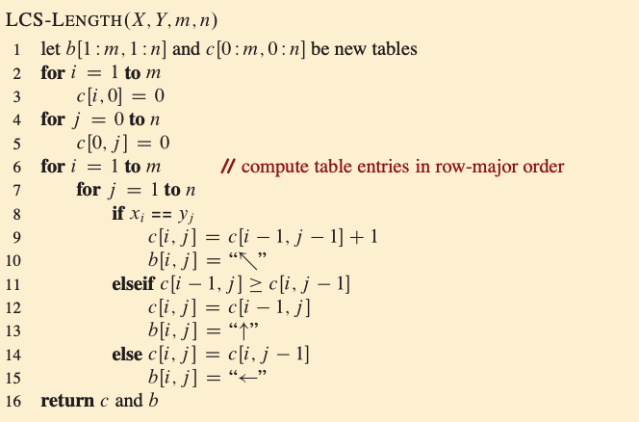

Solving longest common subsequences problem
Step 3: Computing the length of an LCS
The running time of the procedure is $Θ(mn)$, since each table entry takes $Θ(1)$ time to compute.
The table also takes $Θ(mn)$ space.

Slide 10
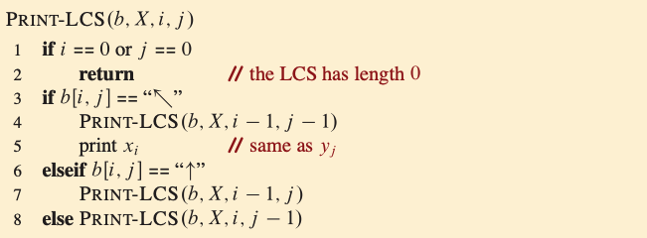

Solving longest common subsequences problem
Step 4: constructing an LCS
The procedure takes $O(m+n)$ time, since it decrements at least one of i and j in each recursive call.

Slide 11
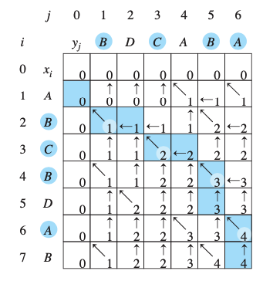
Solving longest common subsequences problem
Step 4: constructing an LCS
The c and b tables computed by LCS-LENGTH on the sequences X = (A, B, C, B, D, A, B) and Y = (B, D, C, A, B, A).
Each square contains the value of c[i,j] and the appropriate arrow for the value b[i,j].
We can see that PRINT-LCS procedure will output (B, C, B, A) here.

Slide 12
Solving longest common subsequences problem
Improving the code
Often, we find that we can improve our algorithm on the time or space it uses.
Some change could simplify code and improve constant factors.
Others could yield substantial asymptotic savings in time and space.

Slide 13

Solving longest common subsequences problem
Improving the code
In LCS algorithm:
You can eliminate the b table and reconstruct LCS in O(m+n) time. (Although it saves $Θ(mn)$ space, the space requirement does not asymptotically decrease as the c table takes $Θ(mn)$ space anyway)
You can reduce asymptotic space requirements for LCS-LENGTH, since it needs only two rows of table c at a time: the row being computed and the previous row. (This improvement works if you need only the length of an LCS.)

Slide 14
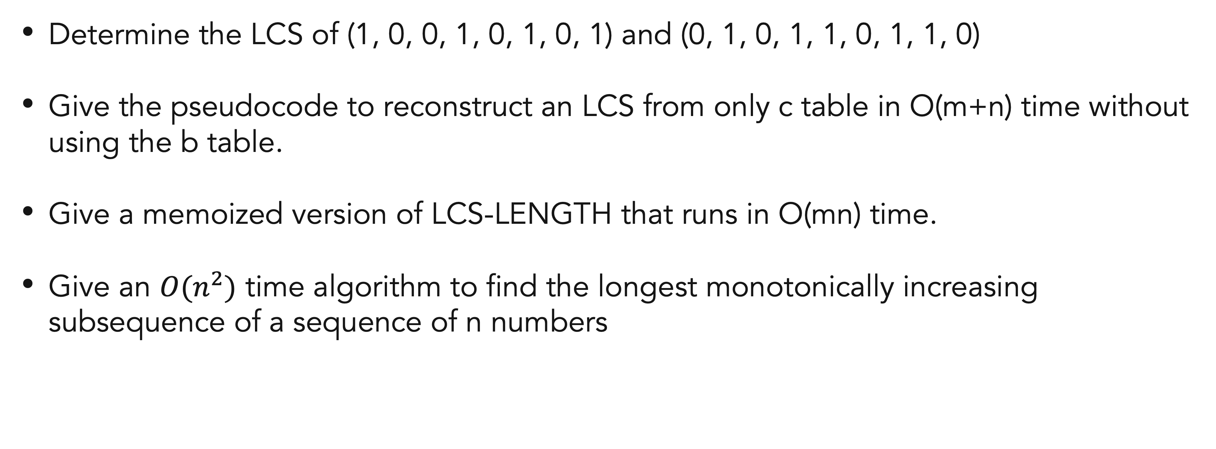
Exercises
17
Determine the LCS of (1, 0, 0, 1, 0, 1, 0, 1) and (0, 1, 0, 1, 1, 0, 1, 1, 0)
Give the pseudocode to reconstruct an LCS from only c table in O(m+n) time without using the b table.
Give a memoized version of LCS-LENGTH that runs in O(mn) time.
Give an $O(n^{2})$ time algorithm to find the longest monotonically increasing subsequence of a sequence of n numbers

Slide 15
References
Thomas H. Cormen. (2022). Introduction to algorithms: Fourth edition. The MIT Press. Chapter 14.

Slide 16
Thank you
Mathematical Induction And Recursive Function
September, 2023

